Slide 1


Netflix Content Analysis
Home
About me
What I do
My experience
My work
Chok Xue Kang, Lim Siew Mooi*
Choo Qi Xiang, Chan Hui Ying
Faculty of Computing and Information Technology.
TAR UMT, KL, Malaysia
12-18 October 2025
LET’S GO

Slide 2
CONTENTS
Home
About me
What I do
My experience
My work
01
02
03
Introduction
Dataset and Exploratory Analysis
Clustering Methodologies
04
05
06
Results and Discussion
Actionable insights & Applications
Conclusion
2

Slide 3
01
The Streaming Landscape
Home
About me
What I do
My experience
My work
01
3

Slide 4

The Streaming Landscape
The rise of digital streaming has revolutionized entertainment consumption.
Home
About me
What I do
My experience
My work
Netflix is a leading global provider with an extensive and diverse content catalogue.
4

Slide 5
NETFLIX THROUGH THE YEARS
Home
About me
What I do
My experience
My work
2018
2000
2006
2020
2016
Netflix.com launched
Starts personal recommendation
Billionth DVD Delivery
Canadian Launch
Goes Global
1997
1998
2003
2007
2012
2021
Founded
Mail Service
Goes Public
Streaming service
UK Launch
Netflix & Chill
5

Slide 6


The Challenge
Home
About me
What I do
My experience
My work
How can we effectively organize and understand this vast library to meet evolving audience preferences?
Our objective
Apply clustering techniques to segment Netflix’s content based on its attributes. This will help uncover latent patterns and support data-driven strategies for:
Content acquisition and production
Personalised recommendations
6

Slide 7
Dataset and Exploratory Analysis
Home
About me
What I do
My experience
My work
02
7

Slide 8
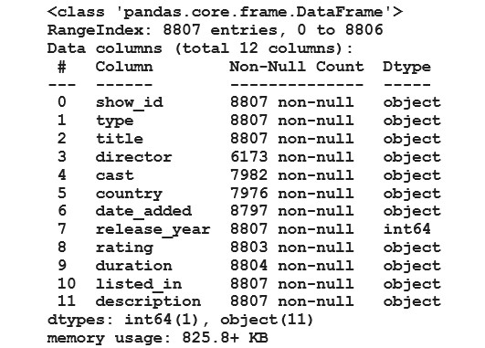
The Dataset
Source: Kaggle dataset on Netflix Movies and TV Shows
Home
About me
What I do
My experience
My work
Key Features:
type
title
country
release_year
rating (content rating)
duration
listed_in (genre)
description
Preprocessing:
Handling missing values (imputation, "Unknown“ category)
Standardising date formats
Validating outliers
8

Slide 9
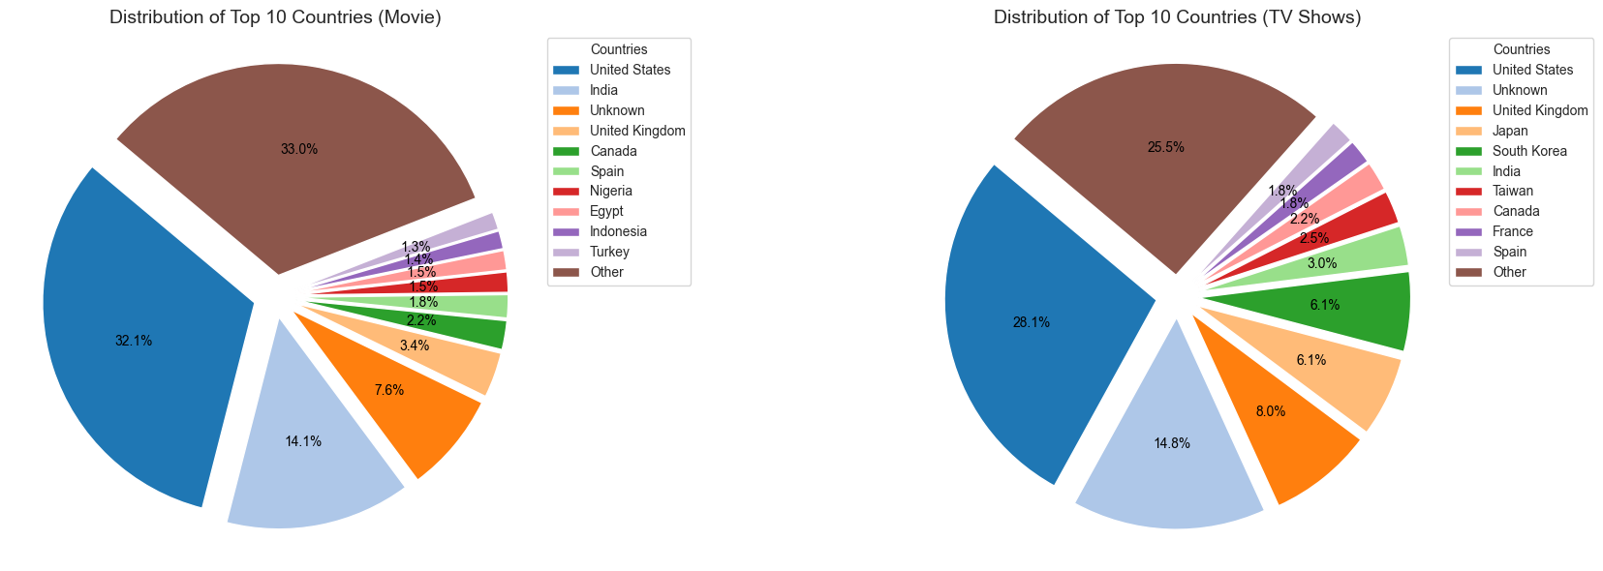
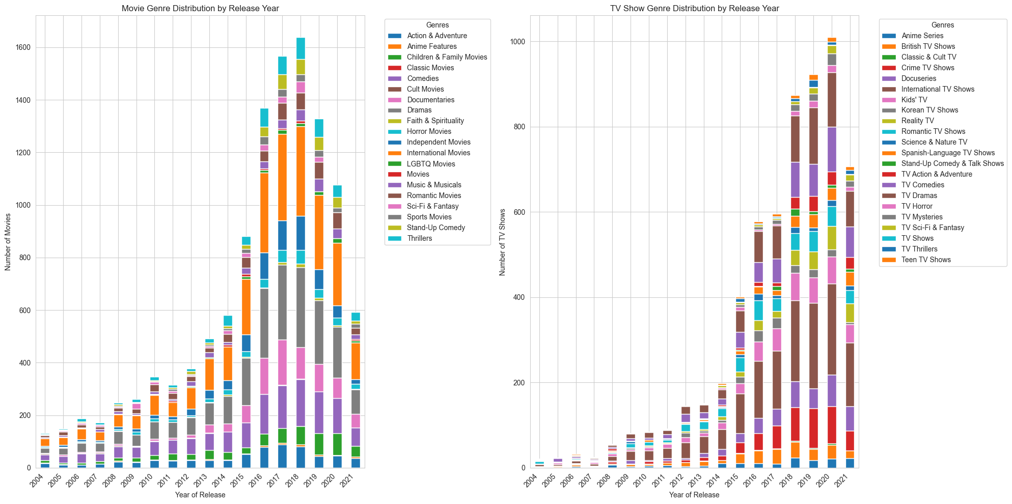
Exploratory Data Analysis (EDA) Highlights
Production Dominance
Content Acceleration
Home
About me
What I do
My experience
My work
The United States leads in content production, followed by India and UK, reflecting global and local strategies.
A significant rise in content added up to 2019, followed by a decline, suggesting a shift from aggressive acquisition to selective curation.
9

Slide 10
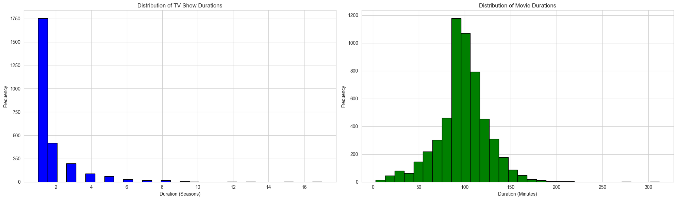
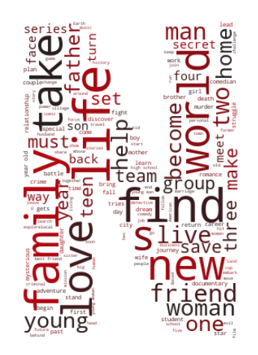
Exploratory Data Analysis (EDA) Highlights
Strategic Durations
Universal Themes
Home
About me
What I do
My experience
My work
TV shows often have 1-2 seasons (optimised for binge-watching), while movies peak at 100-120 minutes.
Lexical analysis of titles and descriptions reveals a focus on universal themes like ”Love,” ”World,” and ”Life.”
10

Slide 11
Clustering Methodologies
Home
About me
What I do
My experience
My work
03
11

Slide 12
A Multi-Method Approach
Latent Dirichlet Allocation (LDA)
Hierarchical Clustering
Spectral Clustering
K-Prototypes Clustering
Home
About me
What I do
My experience
My work
To discover latent themes from content descriptions.
To build a taxonomy of content based on text similarity.
To find non-linear clusters using mixed data types.
To segment content using mixed data types, especially distinguishing between formats and durations.
12

Slide 13
Latent Dirichlet Allocation (LDA)
Home
About me
What I do
My experience
My work
Preprocessing Pipeline
Grid Search Parameters
Model Evaluation
Special character removal
Tokenisation
Stop-word elimination
Lemmatisation
TF-IDF weighting for term importance
TF-IDF features: 500, 1000,2000
Topic numbers: 3, 5, 7
5-fold cross-validation
Log Likelihood optimization
Perplexity minimization
CV coherence measures
Gensim conversion for advanced coherence analysis
13

Slide 14
Hierarchical Clustering
Home
About me
What I do
My experience
My work
Distance Metric Choice
Linkage Strategy
Cluster Selection
Cosine Distance - optimal for high-dimensional text data
Focuses on vector angles rather than magnitudes
Robust to document length variations
Ward’s Linkage – minimizes within-cluster variance
Creates compact, interpretable clusters
Merges clusters with minimum variance increase
Evaluated 3-6 clusters using dendrogram analysis
PCA and t-SNE validation for dimensionality reduction
Balanced granularity with interpretability
14

Slide 15
Spectral Clustering
Home
About me
What I do
My experience
My work
Feature Engineering
Affinity Matrix
Laplacian Regularisation
Mixed-type features: video type, country, year release, rating, genres
Standard scaling for distance computation
Random sampling for computational efficiency
Cosine: Angular similarity
RBF: Gaussian kernel similarity
K-Neighbors: Graph-based connectivity
Unnormalised Laplacian outperformed normalised
Better cluster quality metrics
Superior separation in mixed-type data
15

Slide 16
K-Prototypes
Home
About me
What I do
My experience
My work
Mixed-Type Data Handling
Distance Computation
Cluster Selection
Numerical: Release year, duration
Categorical: Video type, rating (one-hot encoding)
Multi-value: Genres, countries (binary indicators)
Euclidean distance for numerical features
Hamming distance for categorical features
Simultaneous optimization across data types
Elbow method evaluation (k=1-9)
Balanced statistical rigor with business insights
16

Slide 17
Evaluation Strategy
Home
About me
What I do
My experience
My work
Each method requires specialized evaluation metrics due to distinct methodological foundations and data inputs:
Method | Data Type | Evaluation Metrics | Rationale
LDA Topic Modelling | Text | Coherence, Perplexity, Log Likelihood | Generative model for thematic discovery
Hierarchical Clustering | Text | Dendrogram analysis, PCA/t-SNE | Taxonomic structure visualisation
Spectral Clustering | Mixed | Silhouette, Davies-Bouldin, Calinski-Harabasz | Traditional distance-based metrics
K-Prototypes Clustering | Mixed | Elbow method, Within-cluster variance | Mixed-type optimisation
17

Slide 18
Results & Discussion
Home
About me
What I do
My experience
My work
04
18

Slide 19
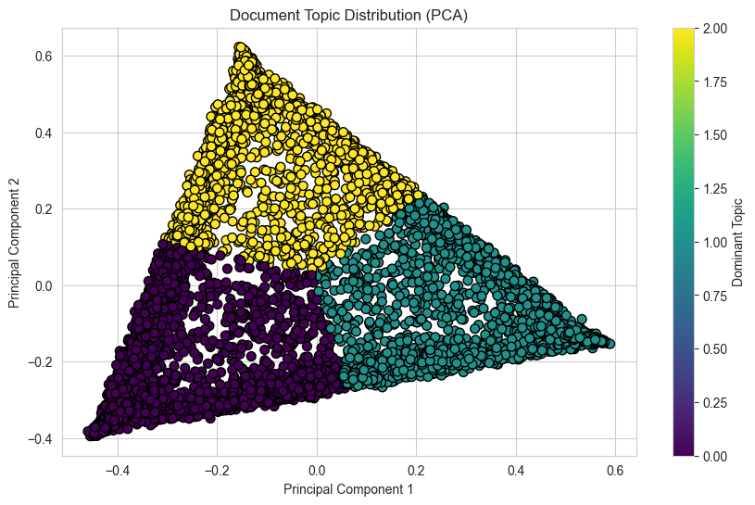
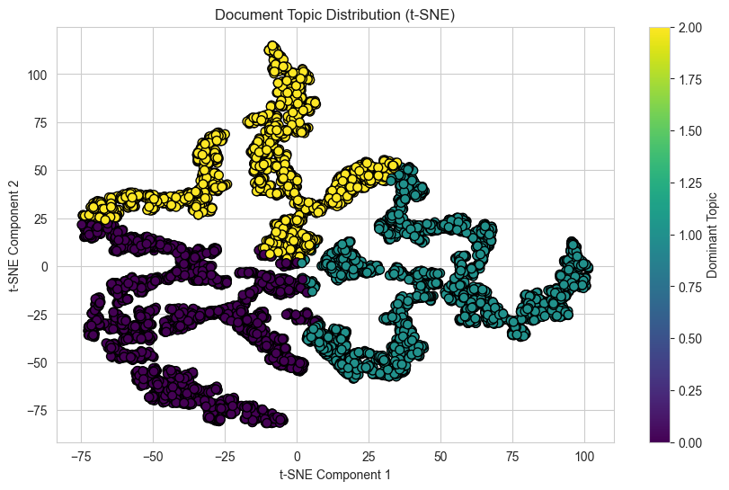
Result 1: LDA
Home
About me
What I do
My experience
My work
LDA revealed three distinct thematic clusters from content descriptions:
Topic 1: Documentaries & Family Narratives (documentary, family, life, father, love)
Topic 2: Action & Crime (force, murder, crime, power)
Topic 3: Entertainment & Series (special, school, team, friend)
Coherence Score: 0.412
Performance Metrics
TF-IDF Features: 500
Perplexity: 678.56
Optimal Topics: 3
19

Slide 20
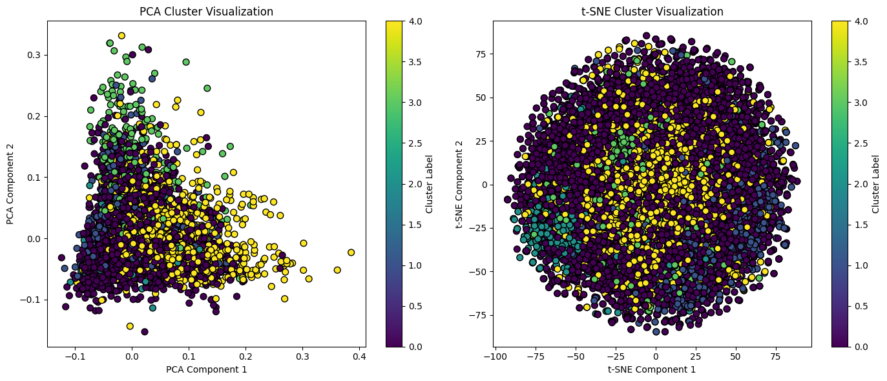
Result 2: Hierarchical Clustering
Home
About me
What I do
My experience
My work
Linkage: ward
Validation:
Dendrogram + PCA/t-SNE
Provided more granular, overlapping themes compared to LDA, reflecting the multi-dimensional nature of content.
Cluster 0: Documentary-style & biographical content
Cluster 1: Science fiction & fantasy themes
Cluster 2: Comedy (especially stand-up specials)
Cluster 3: Coming-of-age & educational themes
Cluster 4: Family dynamics & relationships
Distance: cosine
Clusters: 5 (optimal granularity)
Technical Configuration
20

Slide 21
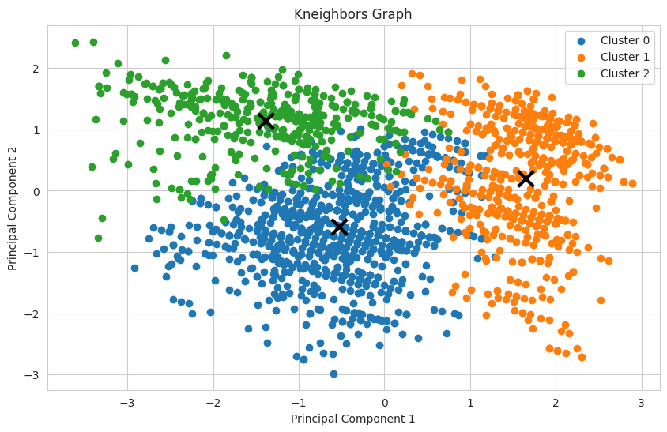
Result 3: Spectral Clustering
Home
About me
What I do
My experience
My work
Identified coherent groups based on geography, release year, and content maturity.
Cluster 0: International Films & Mature Content (circa 2018)
Cluster 1: U.S. TV Shows with Mature Content (circa 2020)
Cluster 2: U.S. Movies, especially restricted Dramas (circa 2017)
Clusters
Key Insight
Highlights how Netflix curates content for specific demographics and regions.
Performance Metrics
Silhouette Score: 0.28, Davies-Bouldin Index: 1.51 Calinski-Harabasz Index: 748.89 Affinity: K-Neighbors (optimal)
21

Slide 22
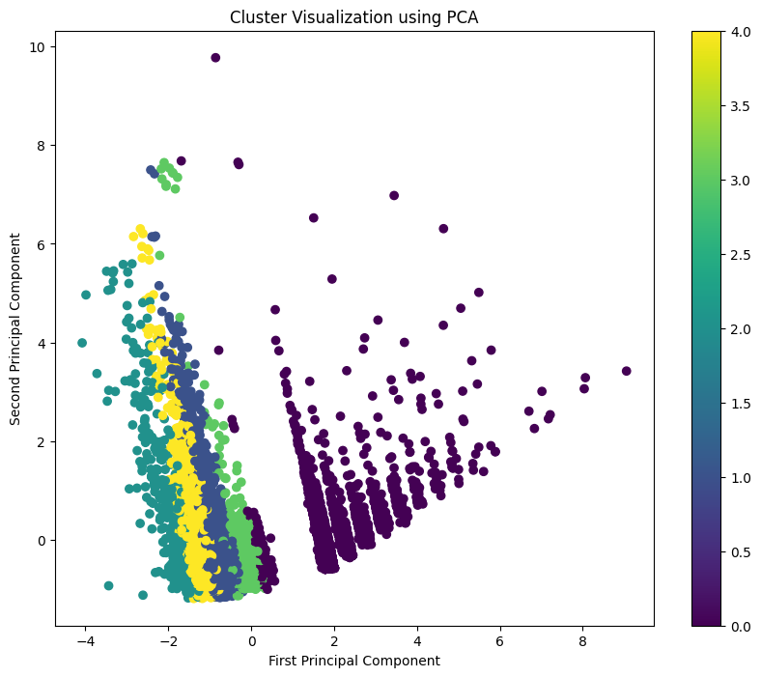
Result 4: K-Prototypes Clustering
Home
About me
What I do
My experience
My work
Effectively segmented the library by format, duration, genre, and origin.
Clusters
Cluster 0: TV Shows
Cluster 1: Standard Movies
Cluster 2: Indian Cinema
Cluster 3: Short-Form
Cluster 4: Medium Dramas
Key Insight
Clear format-duration-origin segmentation supports content strategy and interface personalisation.
Technical Details
Distance: Euclidean + Hamming Features: Mixed-type encoded Elbow Optimum: k=2 Selected: k=5 (interpretability)
22

Slide 23
Actionable insights & Applications
Home
About me
What I do
My experience
My work
05
23

Slide 24
Enhancing Recommendation Systems
Home
About me
What I do
My experience
My work
Recommend content from the same topic cluster (e.g., more "Action & Crime" for a user who watched a thriller).
Thematic Coherence
Suggest relevant content based on user's geographical and maturity preferences (e.g., more international films).
Demographic Targeting
Suggest short-form documentaries for mobile "Quick Watch" rows.
Promote longer cinema for weekend prime-time viewing.
Format-Duration Matching
24

Slide 25


Informing Strategy and Marketing
Home
About me
What I do
My experience
My work
Content Acquisition
Identify saturated segments (e.g., mature U.S. dramas).
Prioritize acquisition in under-represented areas (e.g., international thrillers) to balance the portfolio.
Marketing and Operations
Use LDA themes (”Action,” ”Family”) as copywriting cues for trailers and marketing campaigns.
Personalize user interface based on K-Prototypes clusters, promoting content that matches likely viewing habits (e.g., time of day, device).
25

Slide 26
Conclusion & Future Work
Home
About me
What I do
My experience
My work
06
26

Slide 27
Conclusion
Home
About me
What I do
My experience
My work
Future Work
LDA & Hierarchical
Revealed the thematic structure and marketing language used in content descriptions
Perform network analysis based on shared attributes like actors, directors, and genres to uncover more complex, hidden relationships within the content library.
Uncovered distinct patterns based on content geography, release trends, and maturity ratings
Spectral Clustering
K-Prototypes
Segmented the library into practical categories based on format, duration, and origin
27

Slide 28
THANKS!
Home
About me
What I do
My experience
My work
28

Slide 29


Home
About me
What I do
My experience
My work
Scan for Project Hub
https://github.com/kevin2190p/Speech_Emotion-and-Smart_IrriGO.git
29

